Slide 1





Meetings on the Status and Future of Global Geoscience
Information Standards, November 2023, Suzhou, China
DDE geoscience information metadata standard
Why DDE geoscience metadata standard?
How DDE geoscience metadata standard is drafted ?
What is DDE geoscience information metadata standards?
How DDE geoscience information metadata implement?
Dr Zhang Minghua
Secretary general, CGI –IUGS
Co-leader, DDE standards group
zminghua@mail.cgs.gov.cn
Dr Stephen Richard
US Geoscience Information (USGIN) Foundation
smrtucson@gmail.com

Slide 2
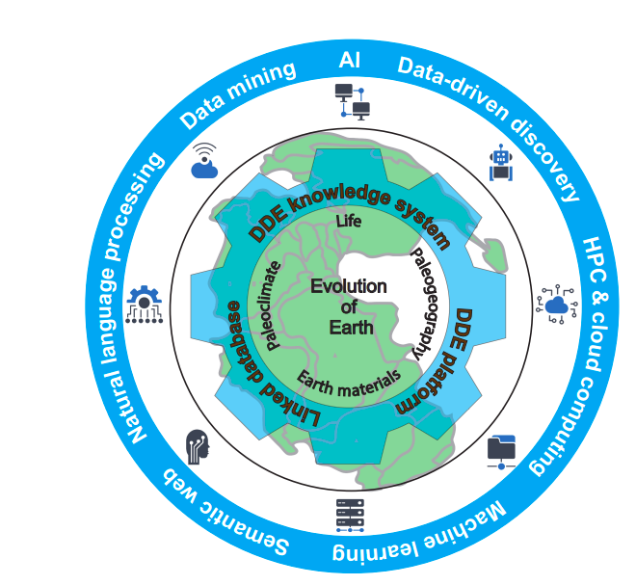
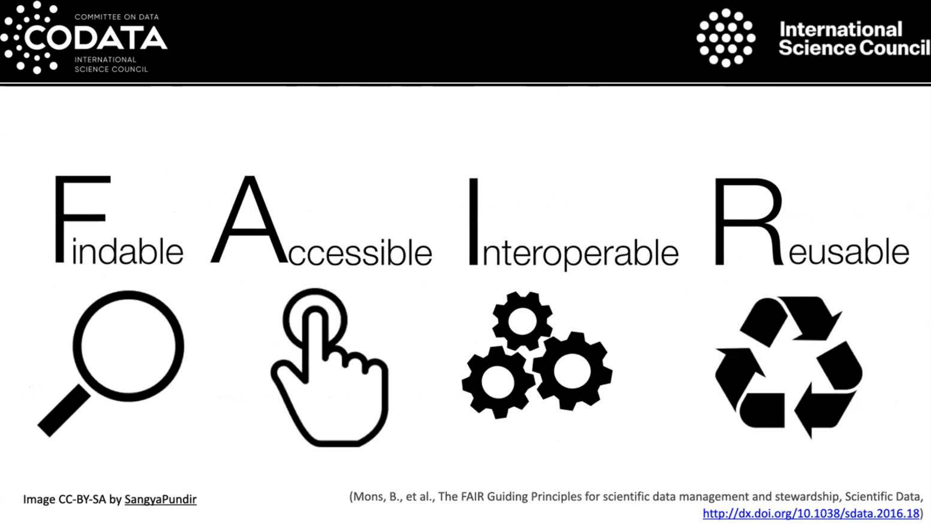
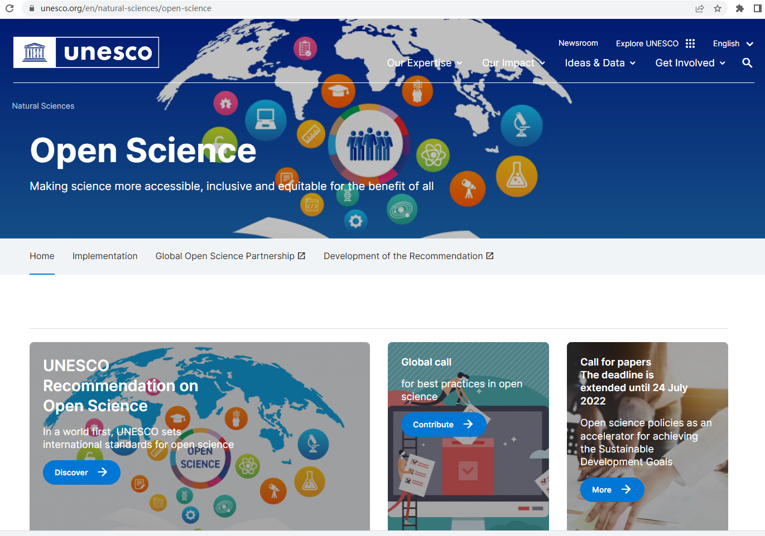
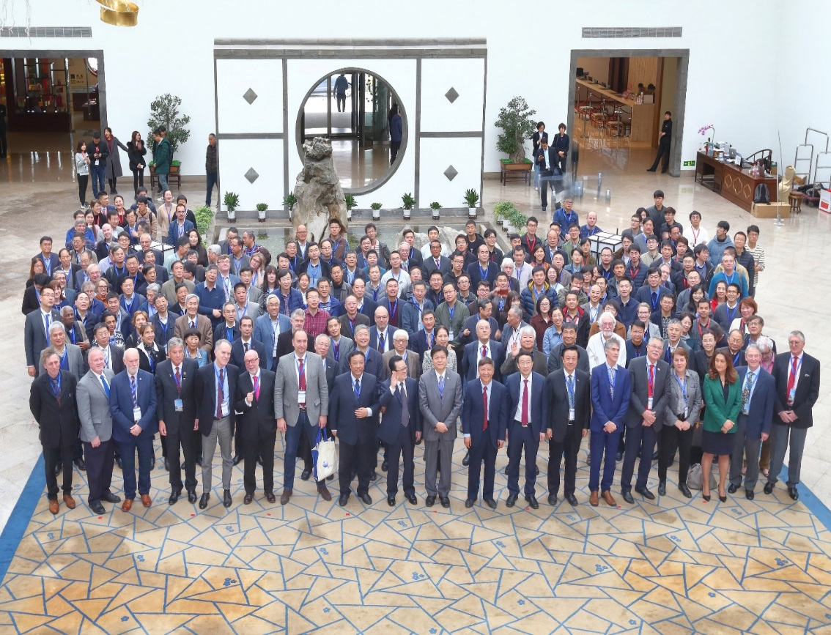
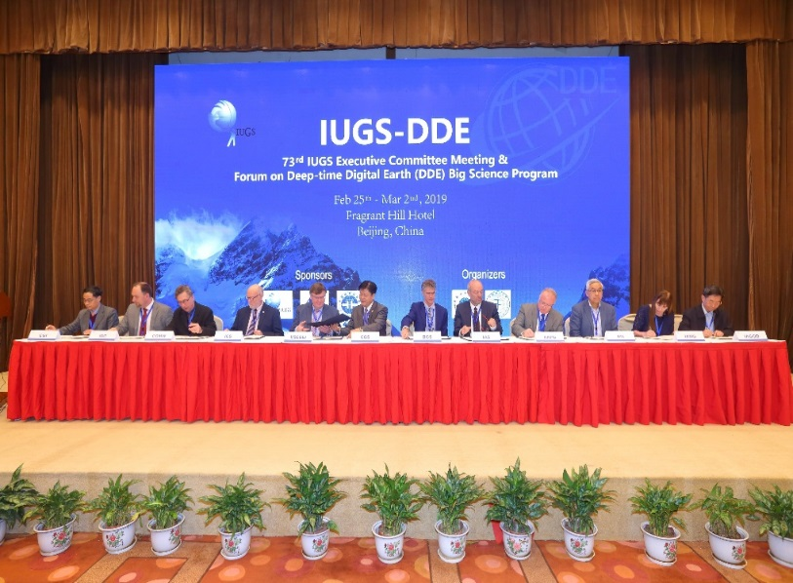
1. Why DDE geoscience metadata ?
Deep-time Digital Earth the first IUGS recognized International Big Science Program up to 2028.
What is DDE?
MOSSION
To harmonize and integrate deep-time Earth data, share global geoscience knowledge, and advance geoscience understanding and research.
VISION
To transform the Earth sciences by fostering a deep-time data-driven research paradigm.
The way forward: FAIR + Open Science
Metadata is import !
Schematic diagram of DDE system,
form Wang et al., 2021, National Science Review
DDE Kick Off Meeting 26-28 Feb. 2019 , Beijing

Slide 3

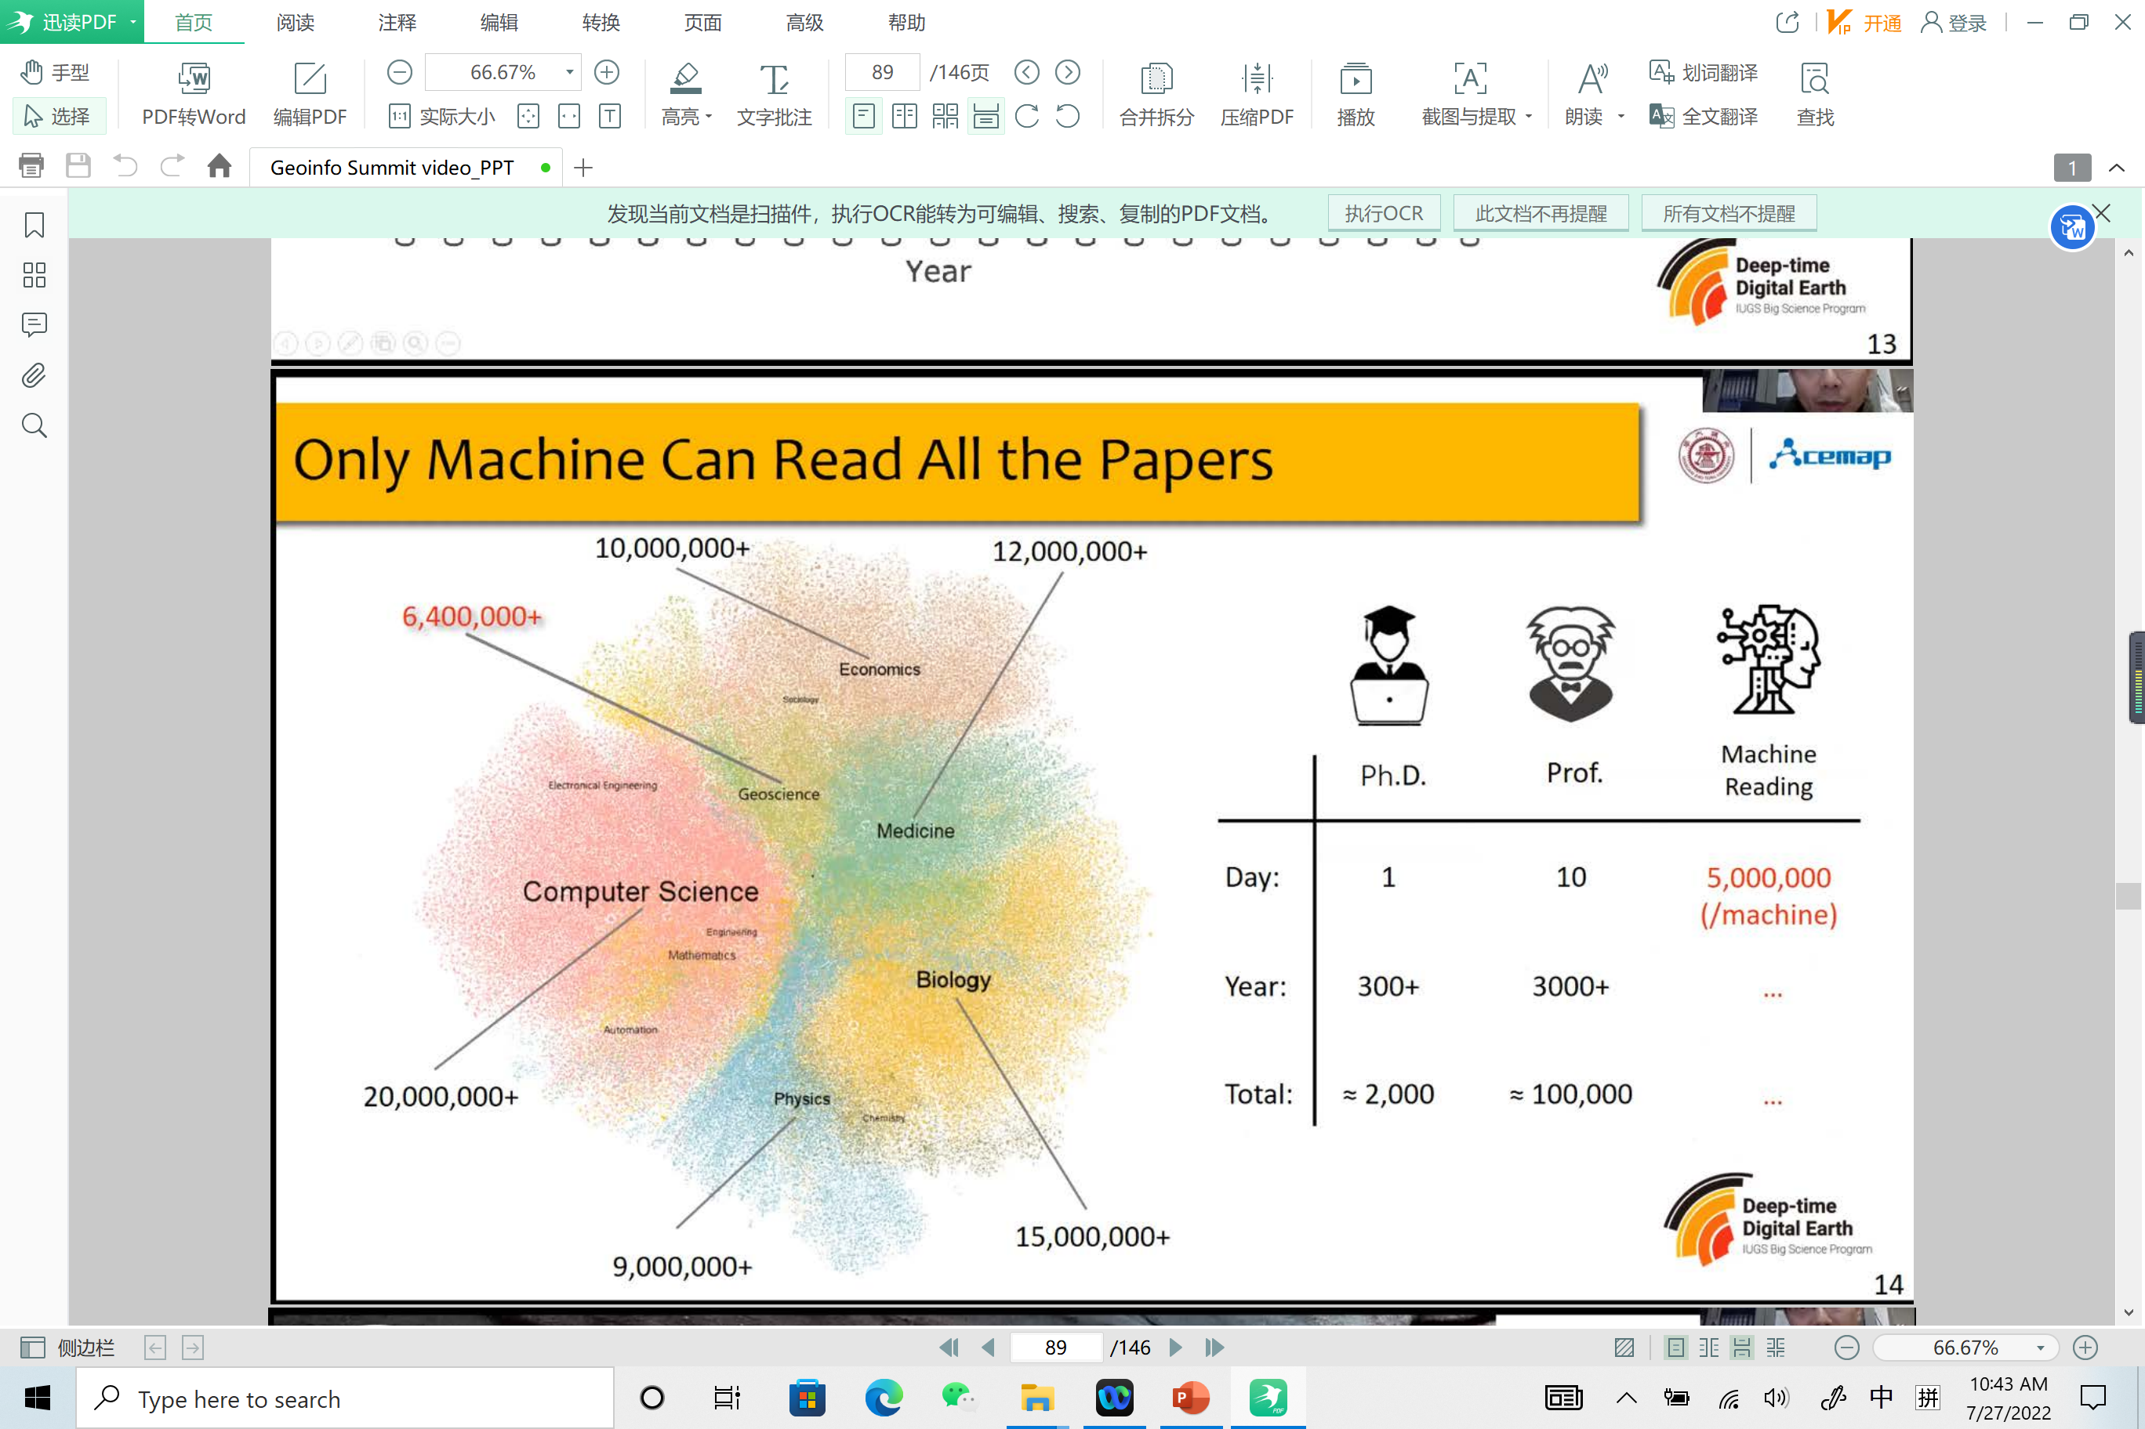
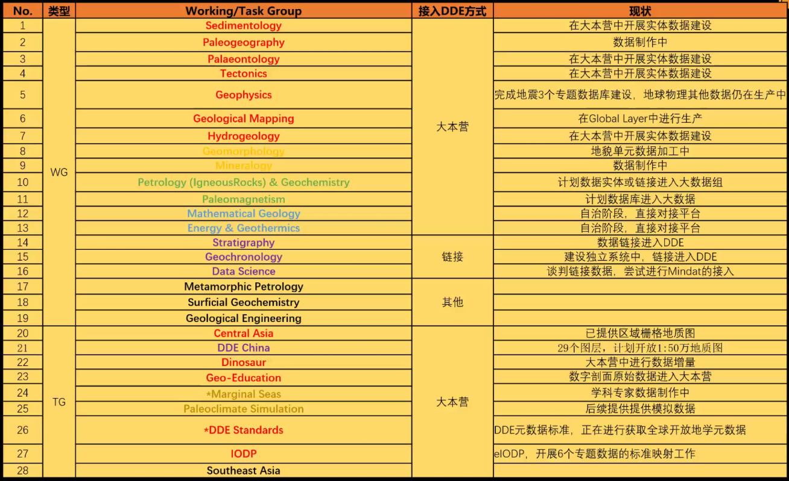
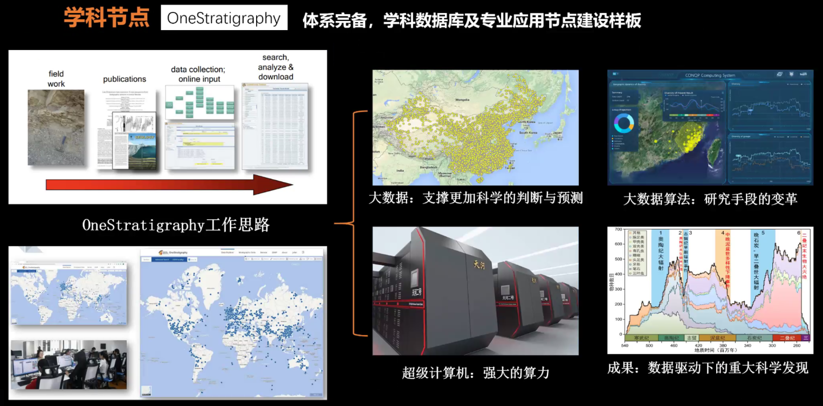
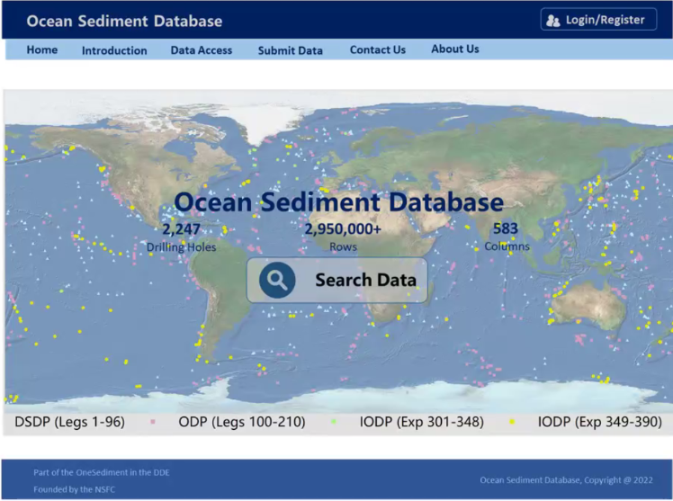
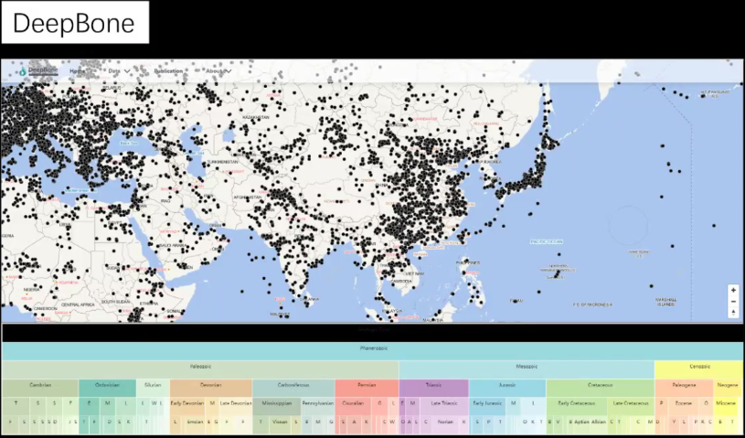
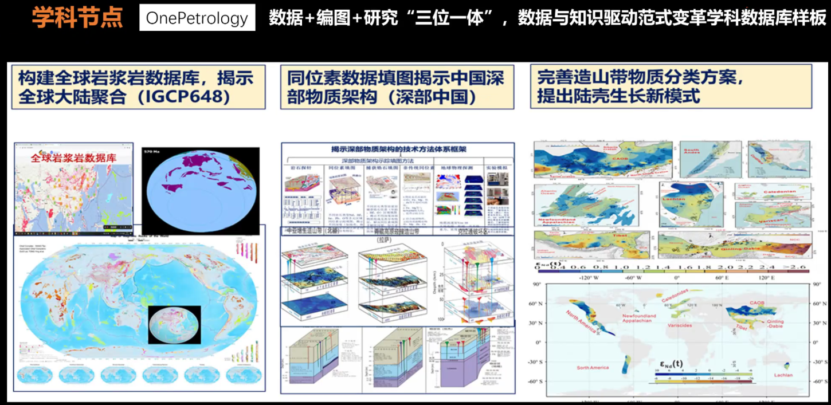
DDE Big Data …
—from Fan Junxuan 20220224 at Geoinfo Summit

Slide 4
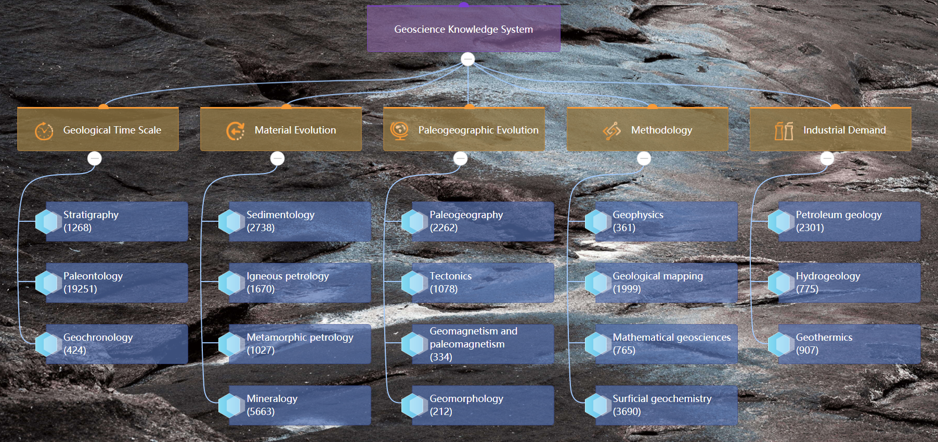
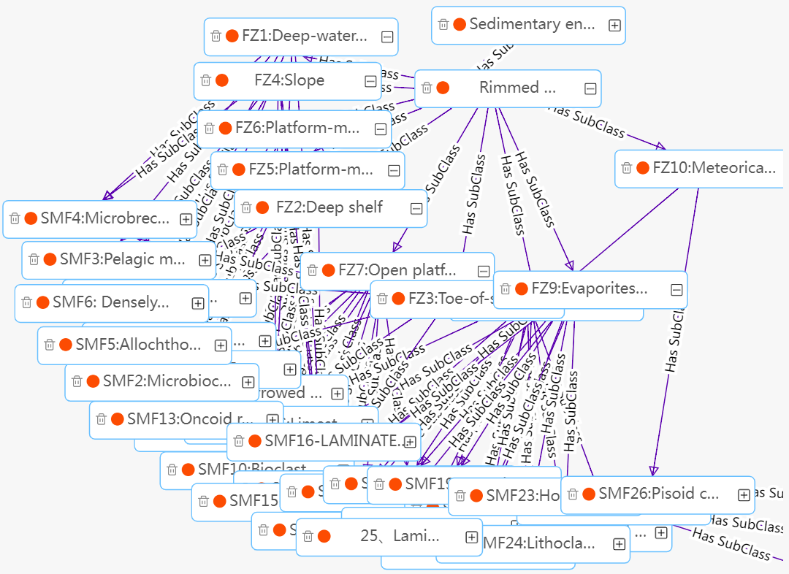
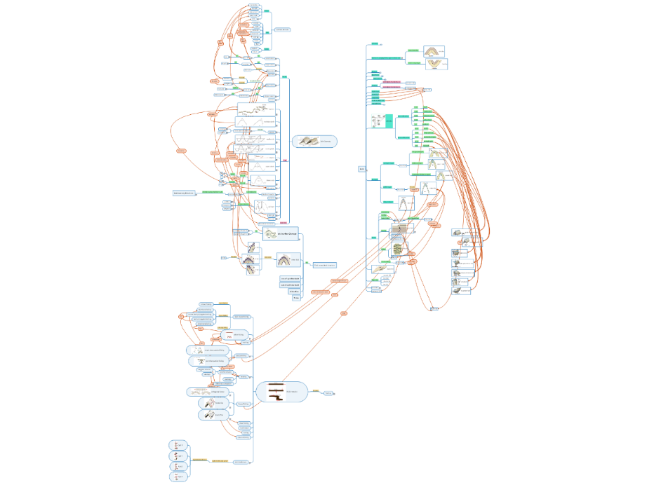
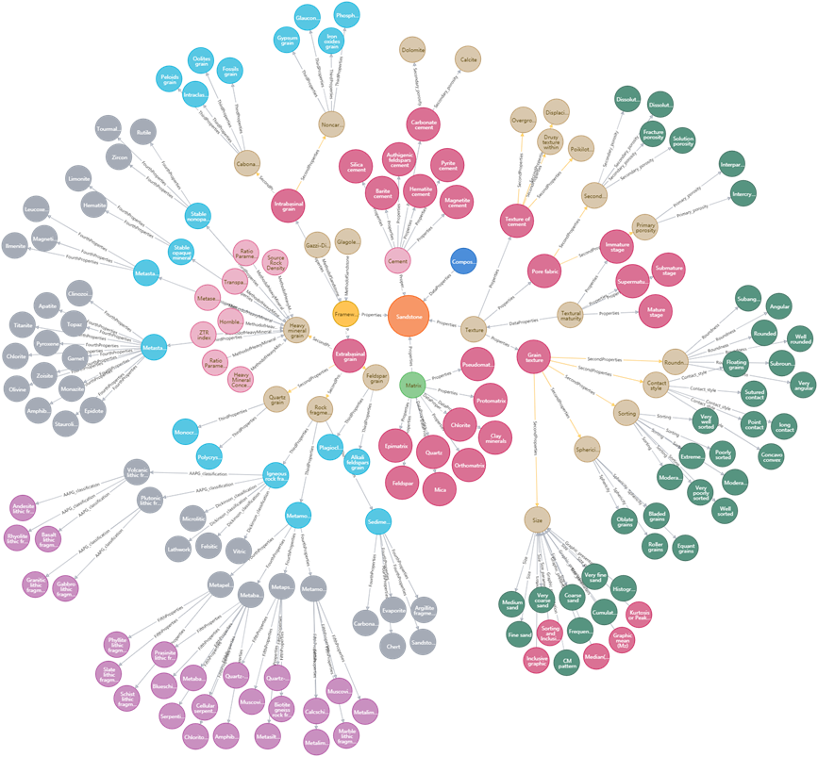
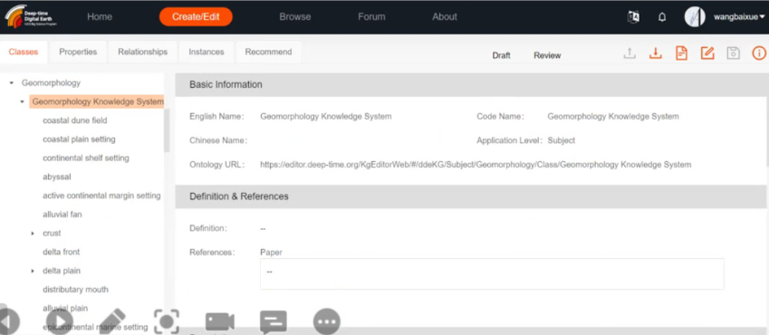
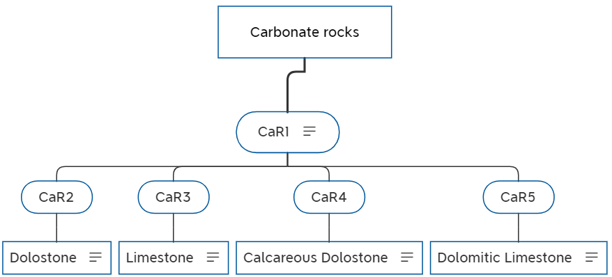
DDE Big Knowledge …
Academic geoscience knowledge system/graph developed thru Top-down and Bottom-up and other methods.
sedimentology, stratigraphy, paleogeography, paleontology, hydrogeology, geomorphology, tectonics, porphyry copper, geohazards, magmatic petrology, geochronology, geothermics, geophysics, geochemistry, petroleum geology, …
Rule nodes | Rule content
CaR1 | The classification is based on relative content of CaCO₃ and CaMg(CO₃)₂
CaR2 | CaCO₃ content <=10%
CaR3 | CaCO₃ content >90%
CaR4 | 10%< CaCO₃ content <=50%
CaR5 | 50% <CaCO₃ content <=90%
Knowledge Graph of Sandstone Based on Neo4j Display
Up to Aug 2022, DDE has constructed 56073 knowledge node and 58193 relations of 20 disciplinaries.
— revised from ppt of Zhu Yunqiang and Hu Xiumian,2022

Slide 5

DDE Coverage and Members
More than 20 working groups (WG) and task groups (TG): very broad coverage of geoscience and other relevant domains.
Data, knowledge and platform services in FAIR and Open.
Paleontology
Stratigraphy
Tectonics
Sedimentology
Paleomagnetism
Geophysics
Mineralogy
Geochemistry
Hydrogeology
Geothermics
Working group
Geomorphology
Geochronology
Metamorphic petrology
Igneous petrology
Petroleum geology
Paleogeography
Geo-education
Geological mapping
Data science
Mathematic Geology
Big data
Platform
Task group
Dinosaur
Paleoclimate modelling
Marginal sea
Southeast Asia
Central Asia
Standards

Slide 6

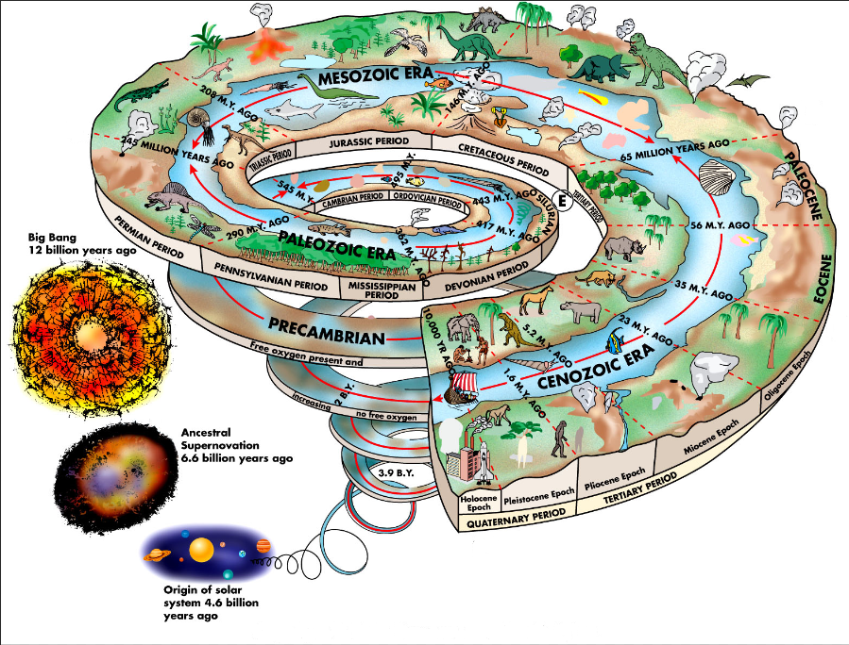
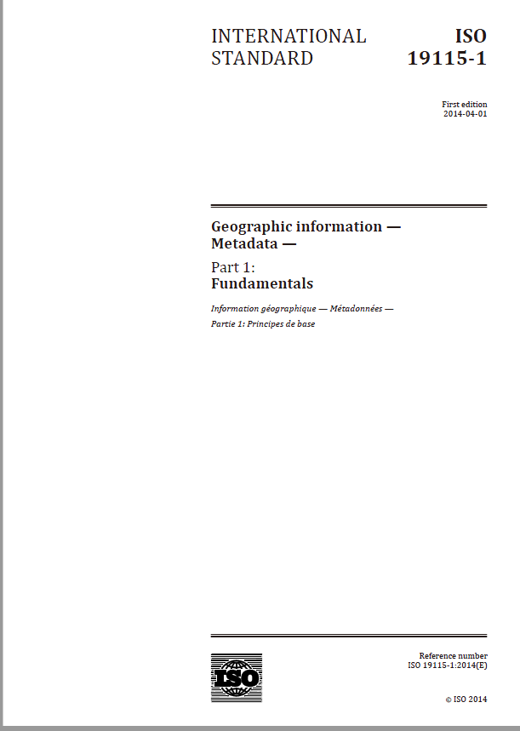
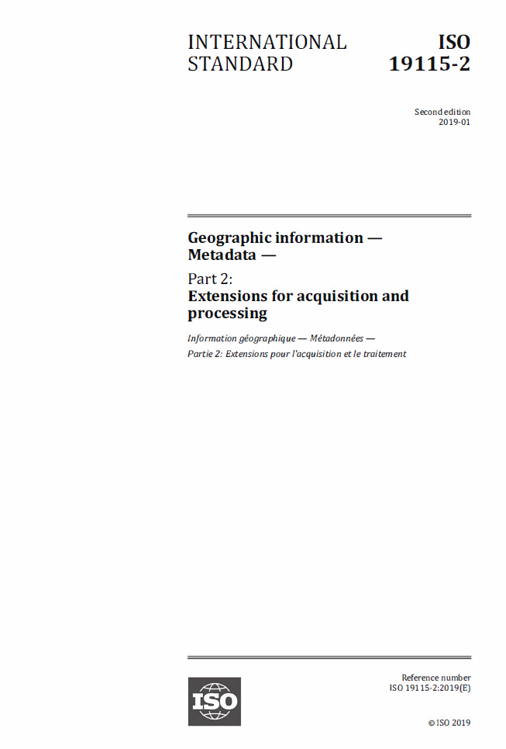
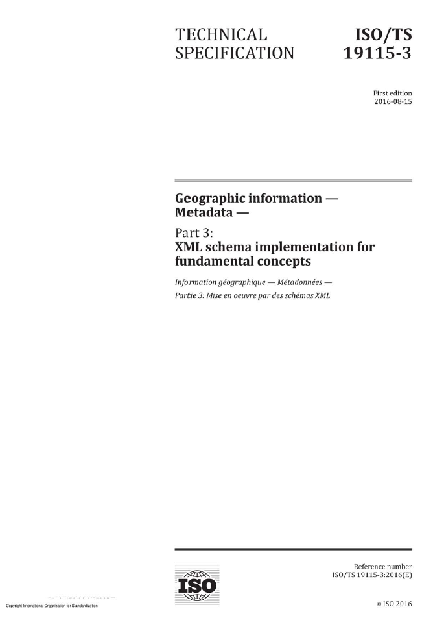
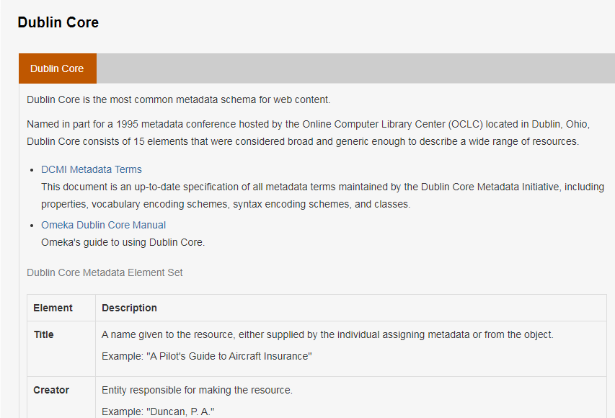
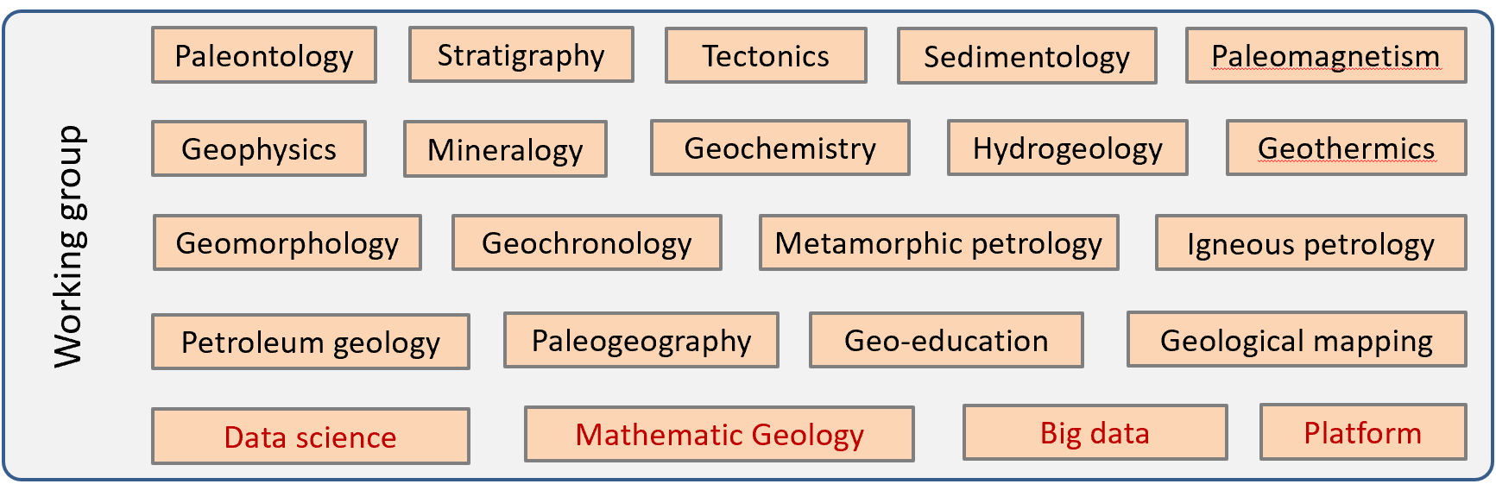
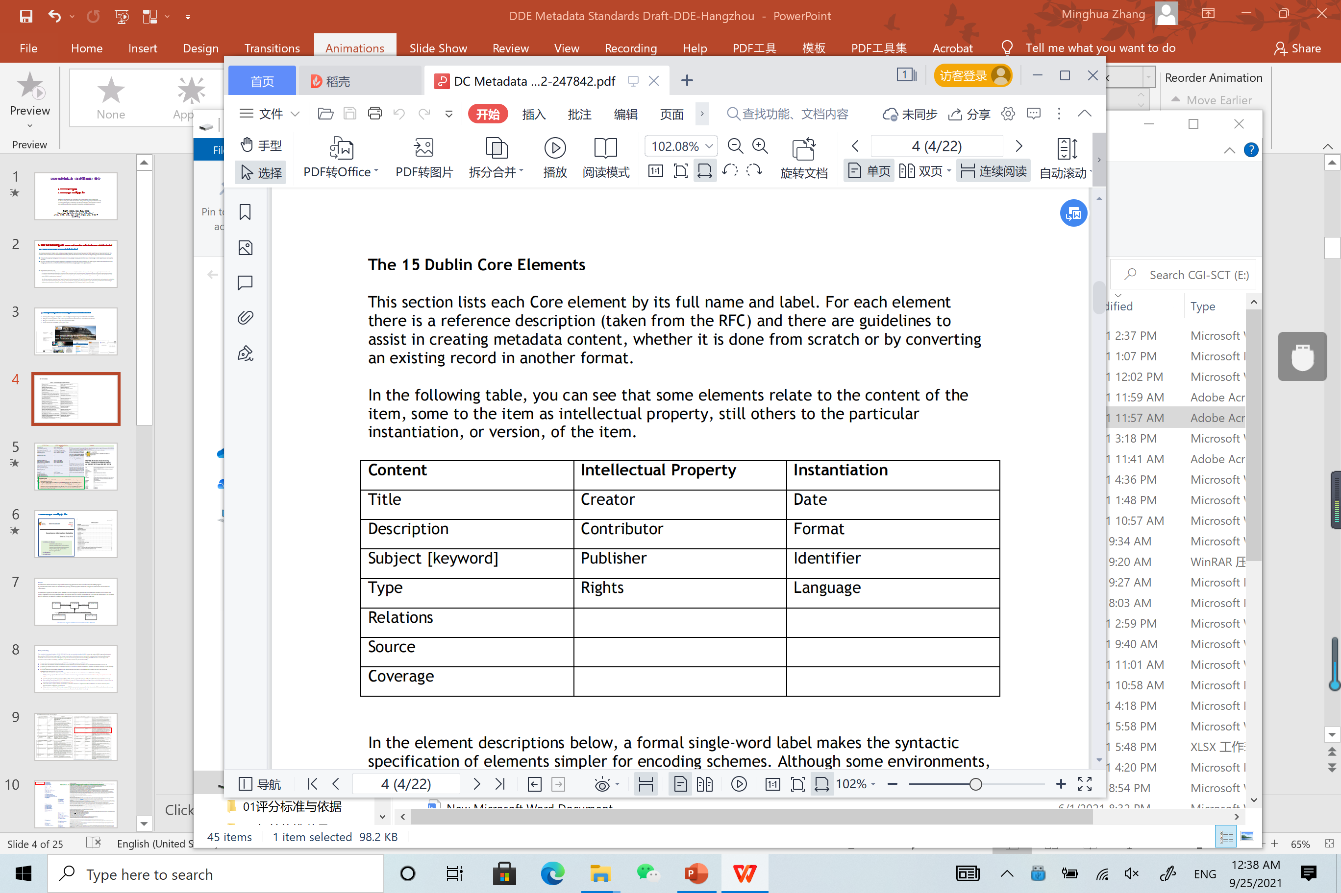
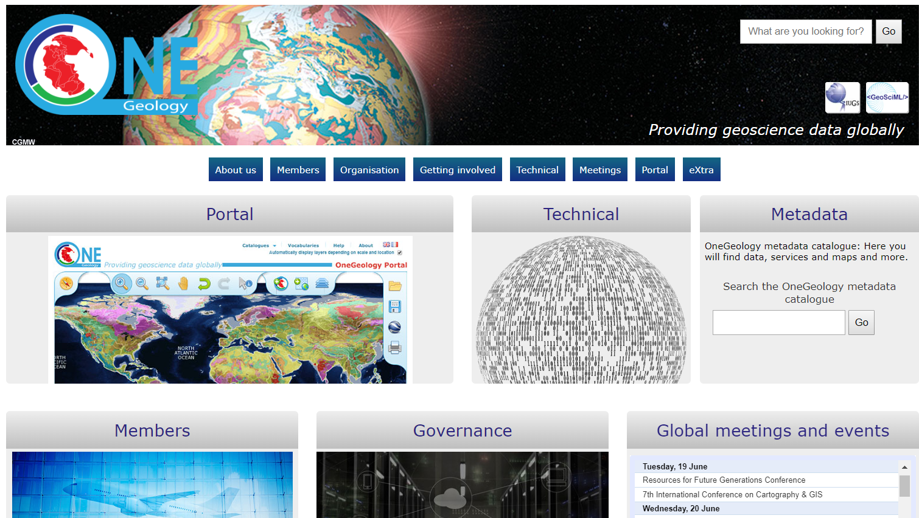
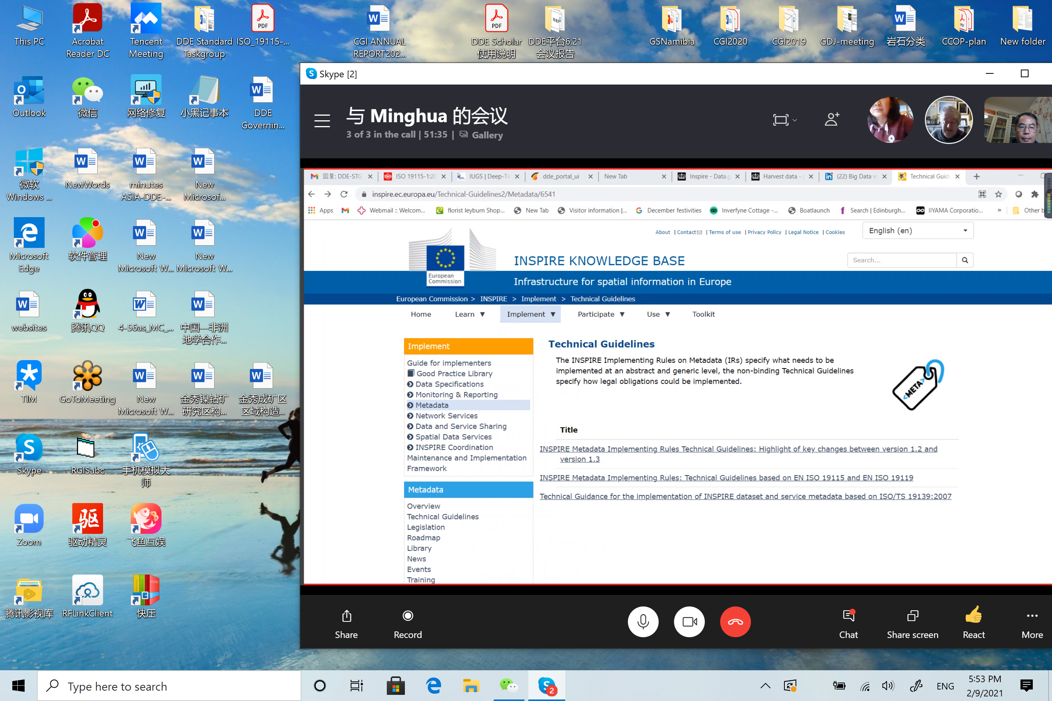
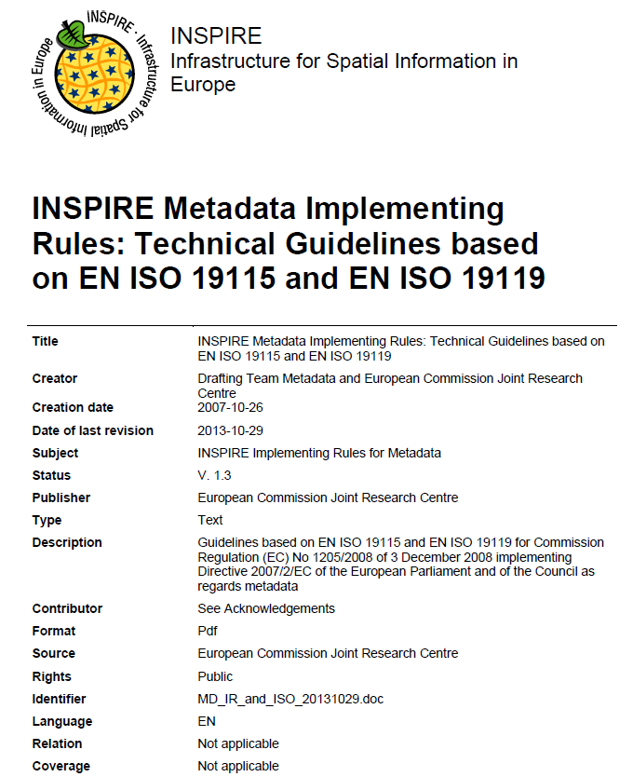
Existing international metadata standards
do not meet the demands of DDE Geoisciences …
Catalog Service for the Web (CSW)
naturphilosophie.co.uk

Slide 7
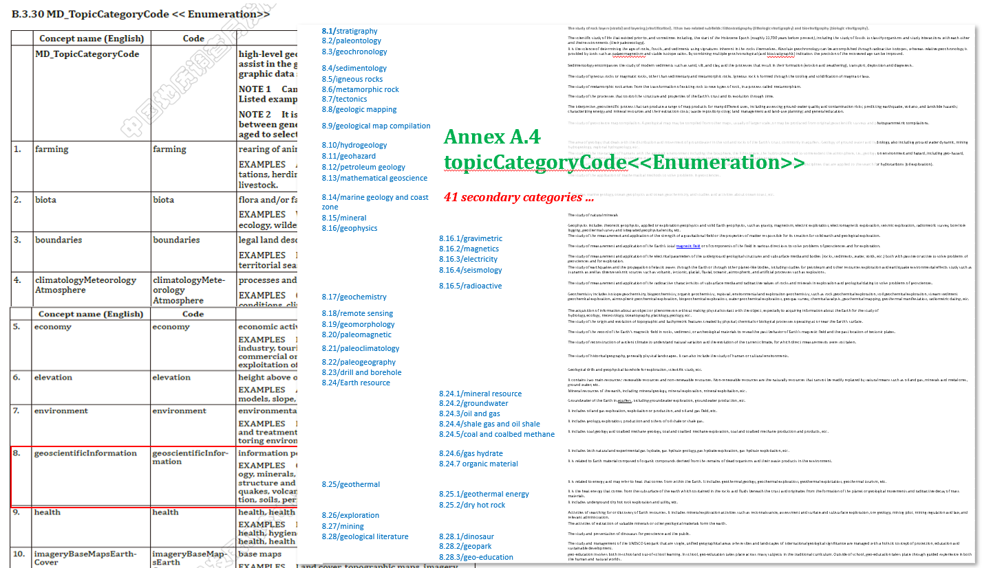
ISO19115-2014(E)
DDE

Slide 8
2. How DDE geoscience metadata standard is drafted ?
Requirement form DDE
Simple and efficient to cover all the disciplinaries of relevant domains for data resource and knowledge Findable and Exchange thru web.
Purpose and coverage of DDE metadata standard
based on existing world-wide implemented standards and web applications to enable data services and information discovery, sharing and protection, etc. to make data FAIR and Open.
Its main contents are focusing on discovery metadata and data services metadata for DDE digital resources classification and category, solution to a unified identification/identifier, and geological time specification.

Slide 9
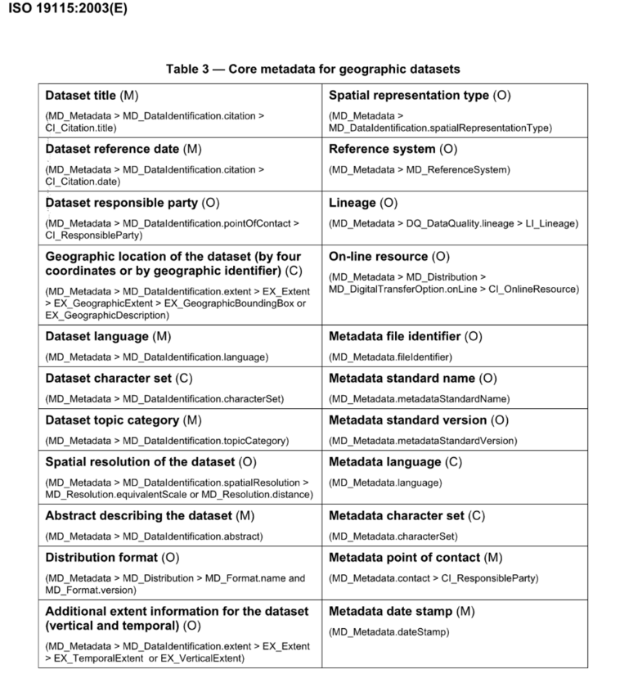
Extension based on ISO 19115 Core metadata
DDE metadata for geoscience datasets
Title（M） | spatialRepresentationType(O)
date（O） | referenceSystemType(C)
ResponsibleParty（O） | Lineage(C)
geographicIdentifer（M） eastBoundLongitude (C) westBoundLongitude(C) southBoundLatitude(C) northBoundLatitude(C) | onlineResource(O)
Language（M） | metadataIdentifier(M)
characterEncoding（M） | metadataStandardName(O)
topicCategory（M） | MetadataReference(C)
spatialResolution（C）
abstract（M）
distributionFormat（O） | distributorContact (MD_serviceInformation)
spatialRepresentationType(O), elevaton(C) | dateInfo (MD_Metadata Information)

Slide 10
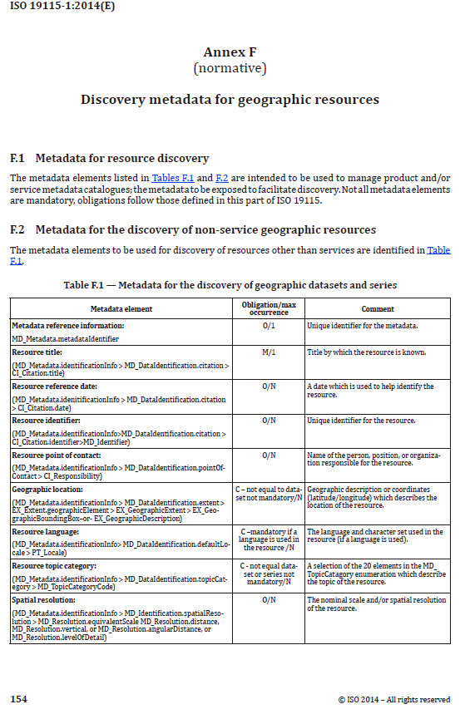
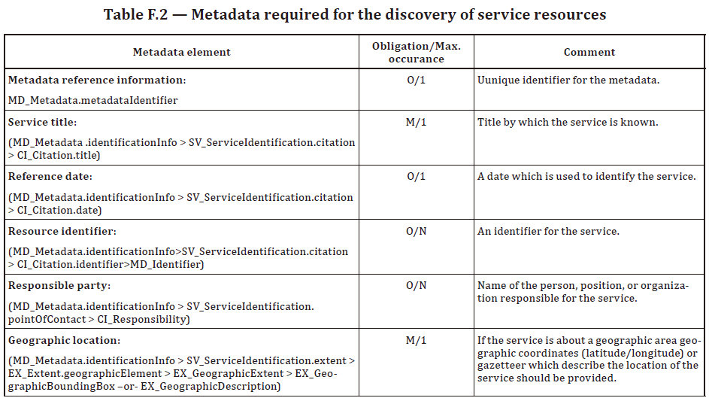
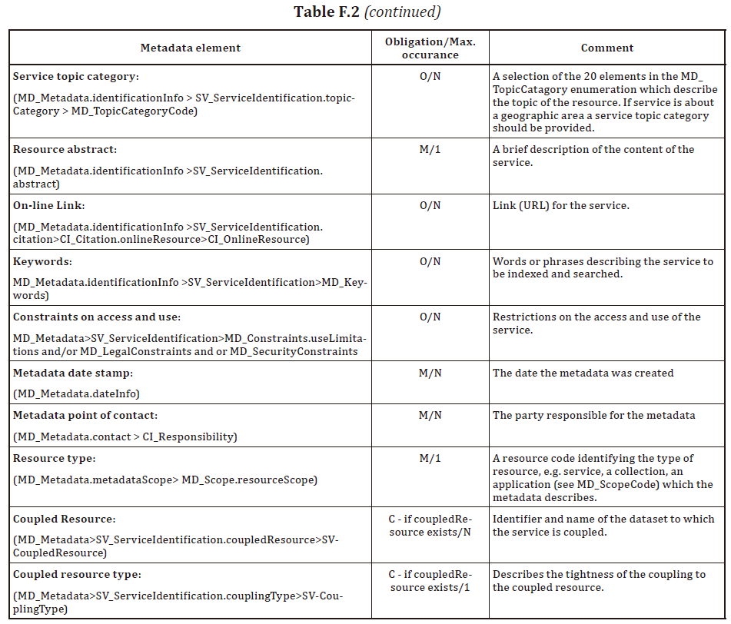
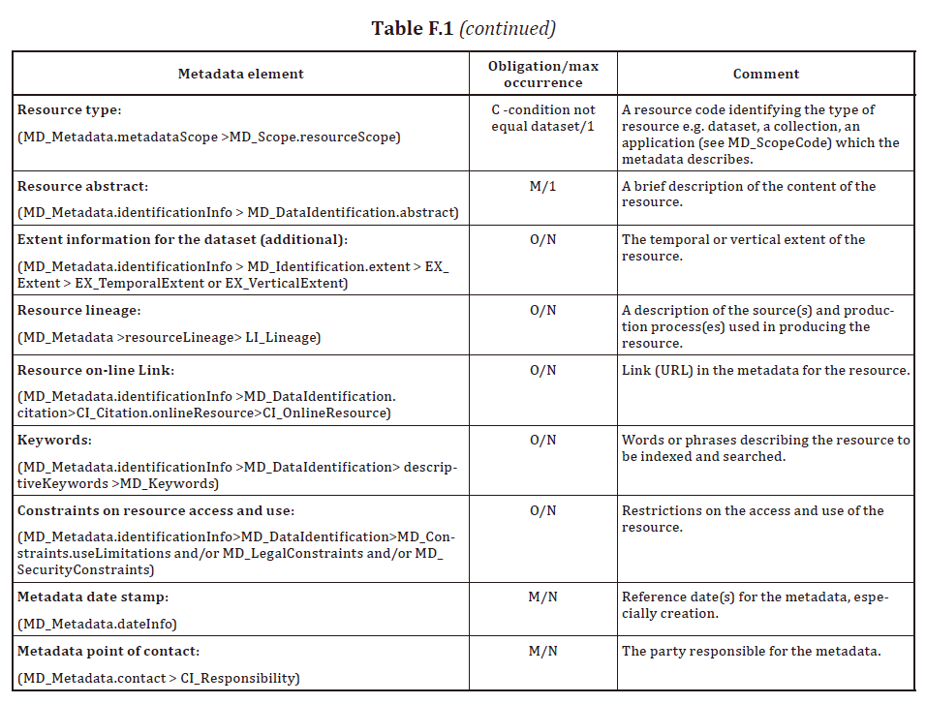
Utilize Discovery Metadata
ISO19115-2014(E)

Slide 11
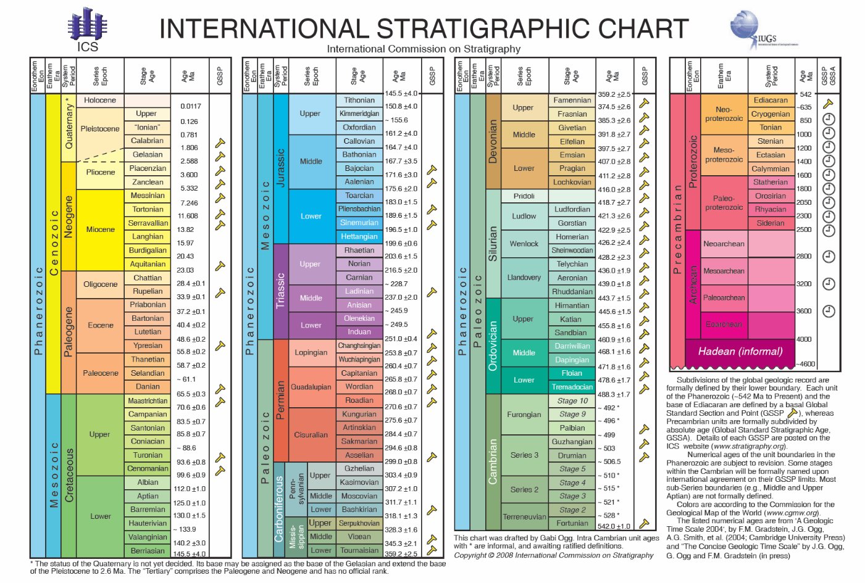
Geological Time Resolution
Geological Time Scale
Named Geological Time Intervals
Gives values for geological time period or age in smallest resolvable geologic time scale unit, from the International Stratigraphic Chart released and updated by International Commission on Stratigraphy of the International Union of Geological Sciences. For example, Upper Jurassic, Holocene, etc. Use the International Stratigraphic Chart (https://stratigraphy.org/chart).
Numeric temporal positions
Geologists typically report a temporal location as a temporal position with coordinates in thousand, million or billion (10^9) years (ka, Ma or Ga) before present. Present is typically take as the year 1950 CE. Values should be reported as decimal numbers for interoperability.
EXAMPLE 201.3 Ma (the age is 201.3 million years). The time point.
Calendar Date and Time
Calendar dates are specified using strings based on ISO 8601 The precision of the date can be defined by showing a combination of century plus year plus month plus day, e.g. YY (century), YYYY (year), YYYY-MM (year-month), YYYY-MM-DD (year, month and day).
A time is specified by appending an hour, minute and second to a year, month and day string, based on ISO 8601. The DateTime definition allows the less precise values. For example YYYY-MM-DDThh (year, month, day, hour), YYYY-MM-DDThh:mm (year, month, day, hour, minute), YYYY-MM-DDThh:mm:ss.d (year, month, day, hour, minute, second and decimals of seconds). The time zone should also be added, e.g. YYYY-M-DDThh:mm:ss.d+hh:mm. Inclusion of the punctuation in the date or dateTime strings is critical to enabling parsing of the time position values.

Slide 12
Data code and Geoscience data acquisition Code
DDE Data Code
A.1 AcquisitionCode<<CodeList>>
No | Concept name | Code | Definition
 | MD_ AcquisitionCode |  | Acquisition and obtain method of the dataset or resource.
1. | Geological mapping | geologicalMapping | Data collected and acquisition mostly in the field by profiling and stationary observation, sampling, and following laboratory analysis, etc., typically, regional field geological mapping
2. | Survey | survey | Data collected with equipment records and following processing with planned profile, or areal/regional data acquisition activity, etc., typically, aeromagnetic survey.
3. | Observation | observation | Data collected by stationary measurement, etc. like ground water monitoring.
4. | Remote sensing | remoteSensing | Data collected with satellites, airplane platform on drone, etc., typically aero-photography and radar.
5. | Drill and borehole | drillBorehole | Collection or records of drills and boreholes.
6. | Analysis with equpments | analysis | Rock specimen and chemical elements analyses in laboratories.
7. | Digital simulation | digitalSimulation | Data generated by digital analyses and simulations with software rather than physical acquisitions.
8. | Data integration and compilation | integrationCompilation | Digital results of data integration and map compilation.
9. | Web resource | webResource | Data and resources obtained from the web.
10. | Other | other

Slide 13
Geosceince Topic Categoryies resolution
Annex A — Geosciences Information Metadata Code List (Normative)
A.1 AcquisitionCode<<CodeList>>
A.2 CharacterSetCode<<CodeList>>
A.3 CountryCode<<CodeList>>
A.4 DateTypecode <<CodeList>>
A.5 FunctionCode <<CodeList>>
A.6 LanguageCode <<CodeList>>
A.7 MD_ProcessedLevelCode<<CodeList>>
A.8 ReferenceSystemTypeCode <<CodeList>>
A.9 ResourceTypeCode <<CodeList>>
A.10 RestrictionCode<<CodeList>>
A.11 RoleTypeCode<<CodeList>>
A.12 ServiceTypeCode RoleTypeCode<<CodeList>>
A.13 SpatialRepresentationTypeCode <<CodeList>>
A.14 topicCategoryCode<<Enumeration>>
Annex B — XML Schema Definition of geoscience information metadata

Slide 14
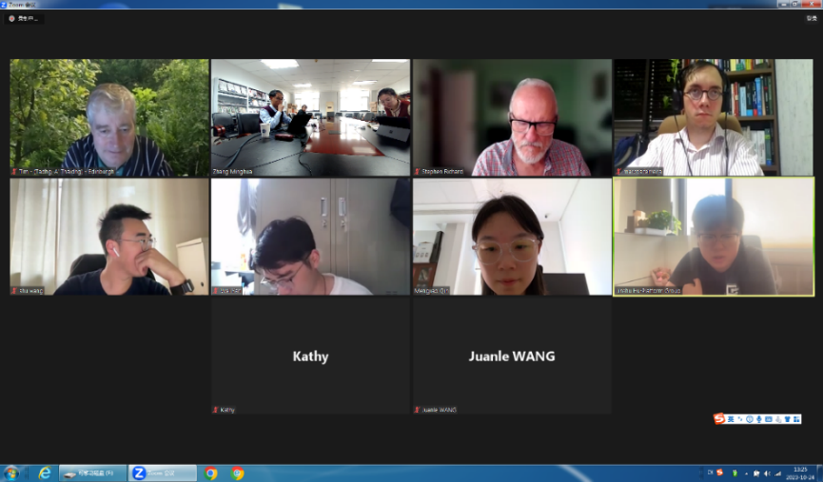
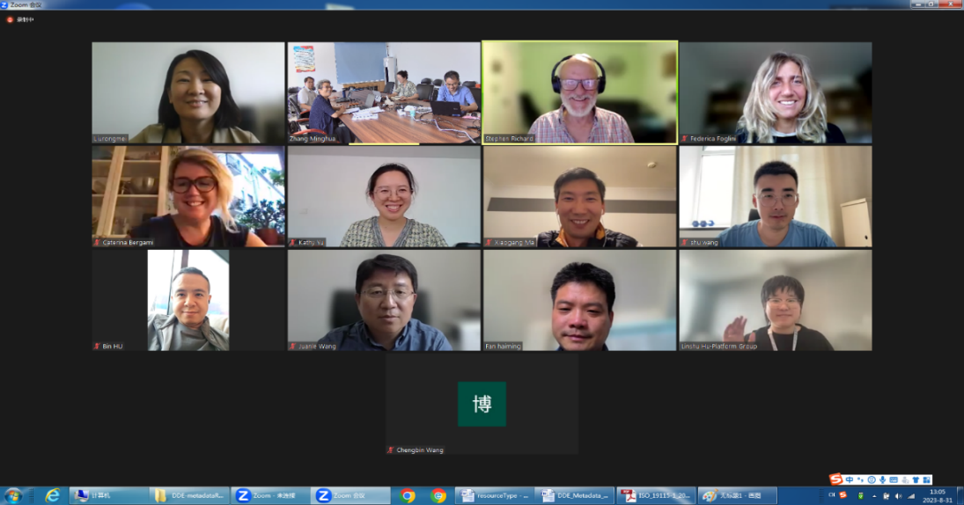
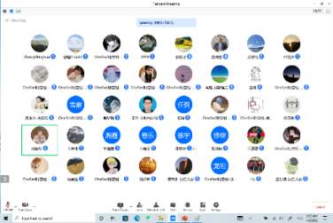
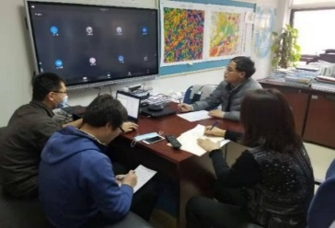
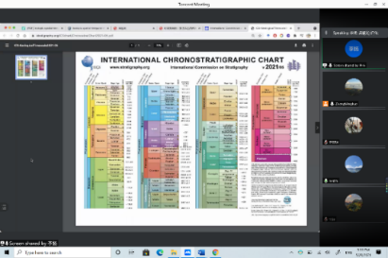
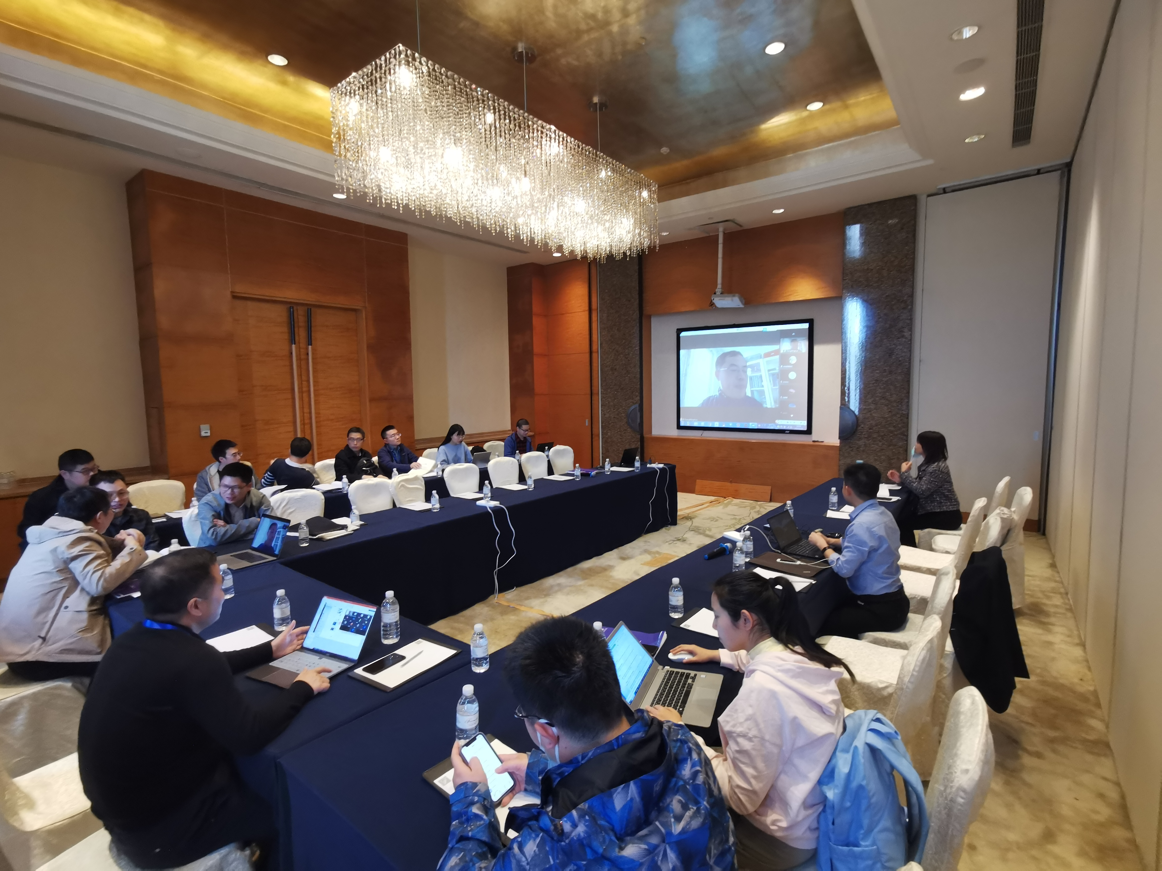
History of DDE geoscience information metadata standard Draft
The standard document was drafted and revised four main times/versions since May 2021 to Oct 2023 by experts and scientists both from and outside the DDE Standards Task Group (DDE-STG) with collaborations of DDE Data Group, Knowledge Group and other DDE Working Task Groups, overcome difficulties caused by the COVID pandemic. It is finalized in the end of Oct 2023.
The Initial version: DDE_Metadata_Standard_draft_20210823.doc, July 2021.
Draft Update1 version:DDE_Metadata_Standard_draft_update1_20211031.doc, November 2021 .
Draft Update2 version: DDE_Metadata_Standard_draft_update2_20221031.doc, Oct 2022.
Draft Update3 near final version: DDE_Metadata_Standard_draft_update3_20230618.doc, May 2023.
Release version: DDE_Metadata_standard_release_2023-11-07. pdf
Discussions
Resource Type
Need to specify the kind of resource described by metadata; this has implications for validation requirement. Different resource might have different requirement.
ISO 19115 CI_RoleCodes for ResponsibleParty
a richer vocabulary for documenting and acknowledging contributions to resource creation and stewardship
License/accessConstraints
A requirement for consistency with FAIR principles.
Rename MD_Metadata/dateInfo to MD_Metadata/metadataDate -- reduce ambiguity
Rename MD_Metadata/responsiblePartyInfo to MD_Metadata/metadataResponsibility-- reduce ambiguity
Rename MD_DataIdentification to MD_Identification-- elements here apply to anything the metadata describes, so more general name is clearer
Finalization Meeting and discussion
31 Aug/24Oct, 2023
Action
Finalize XML schema for DDE
Create XSLT to convert to and from ISO19115-3
Implement GeoNetwork schema profile for DDE
Harvest DDE or ISO19115-3 DDE
Search
Provide results in DDE, ISO19115-3DDE [DCAT, Schema.org, ISO19139]

Slide 15
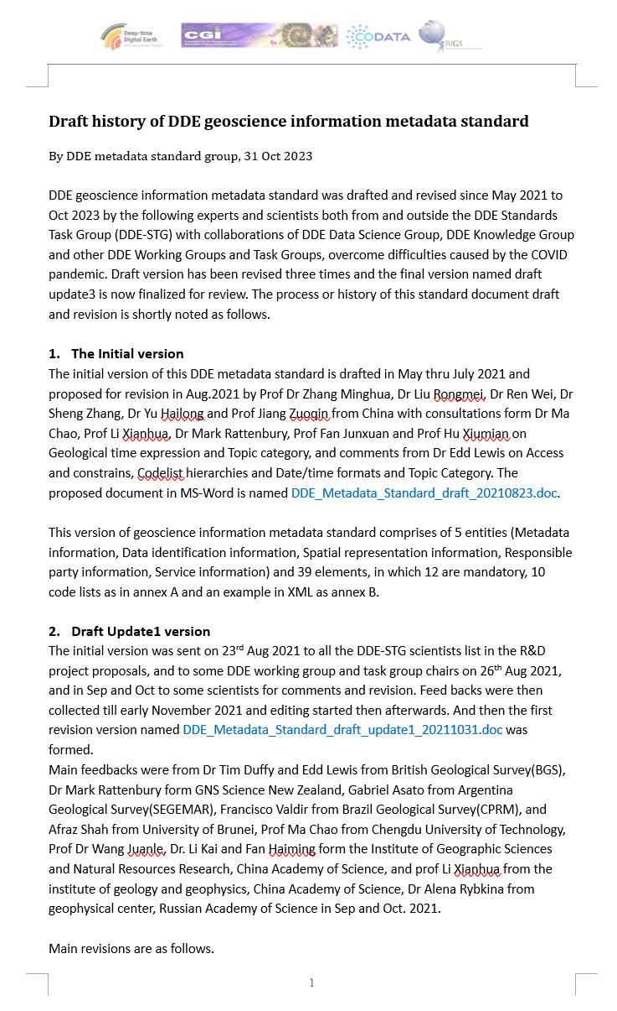

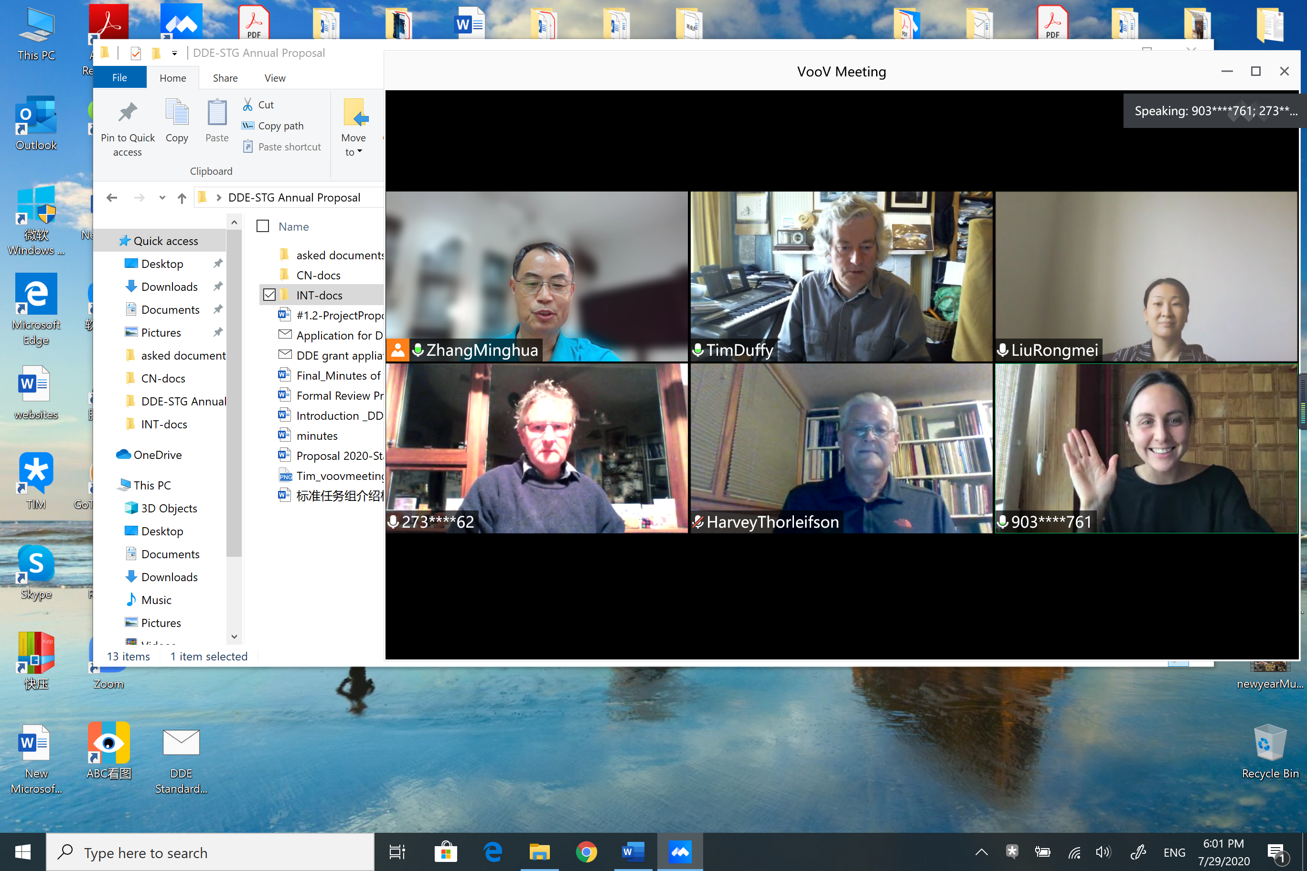



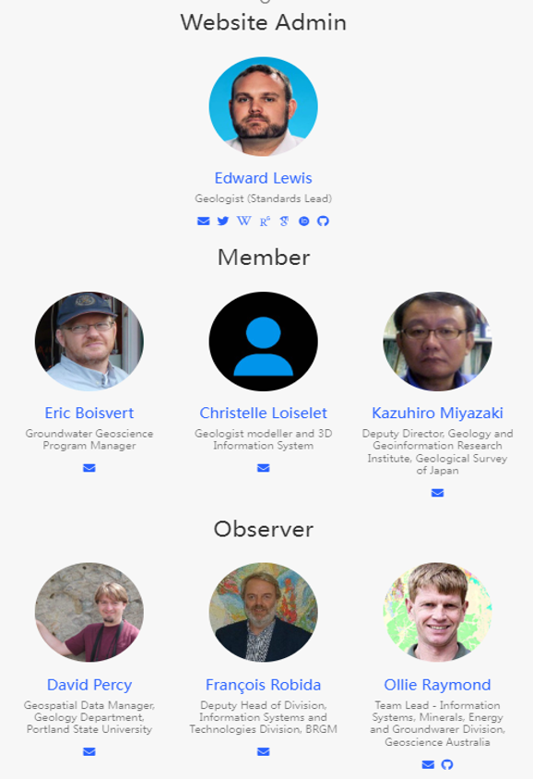


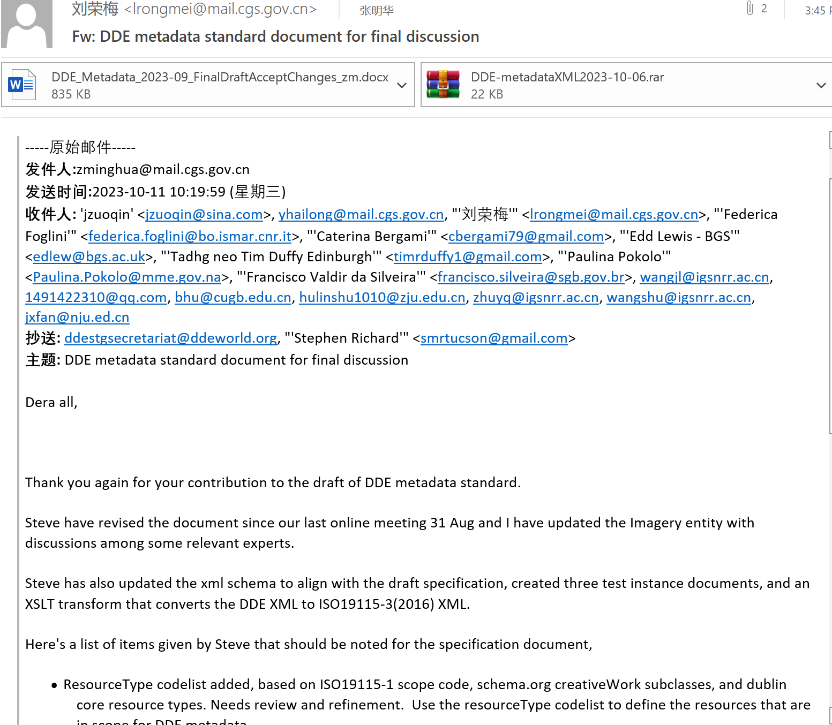
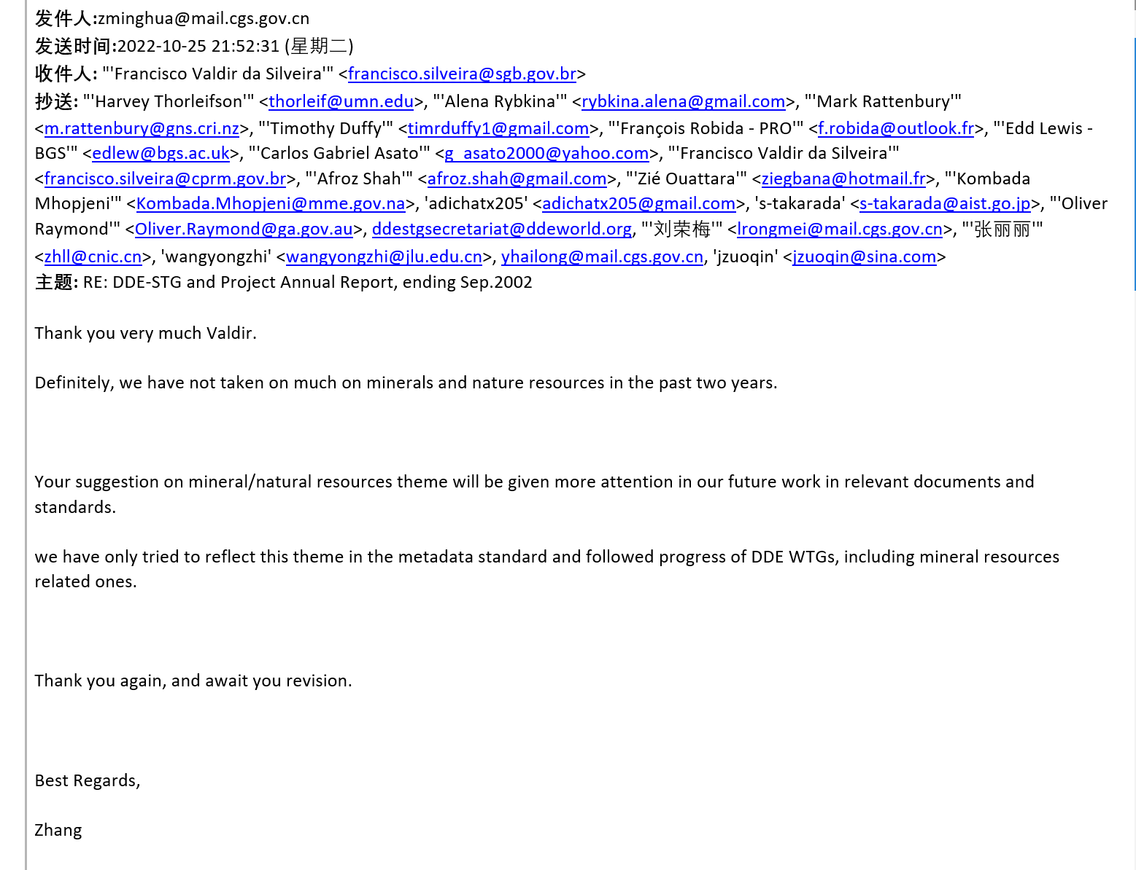
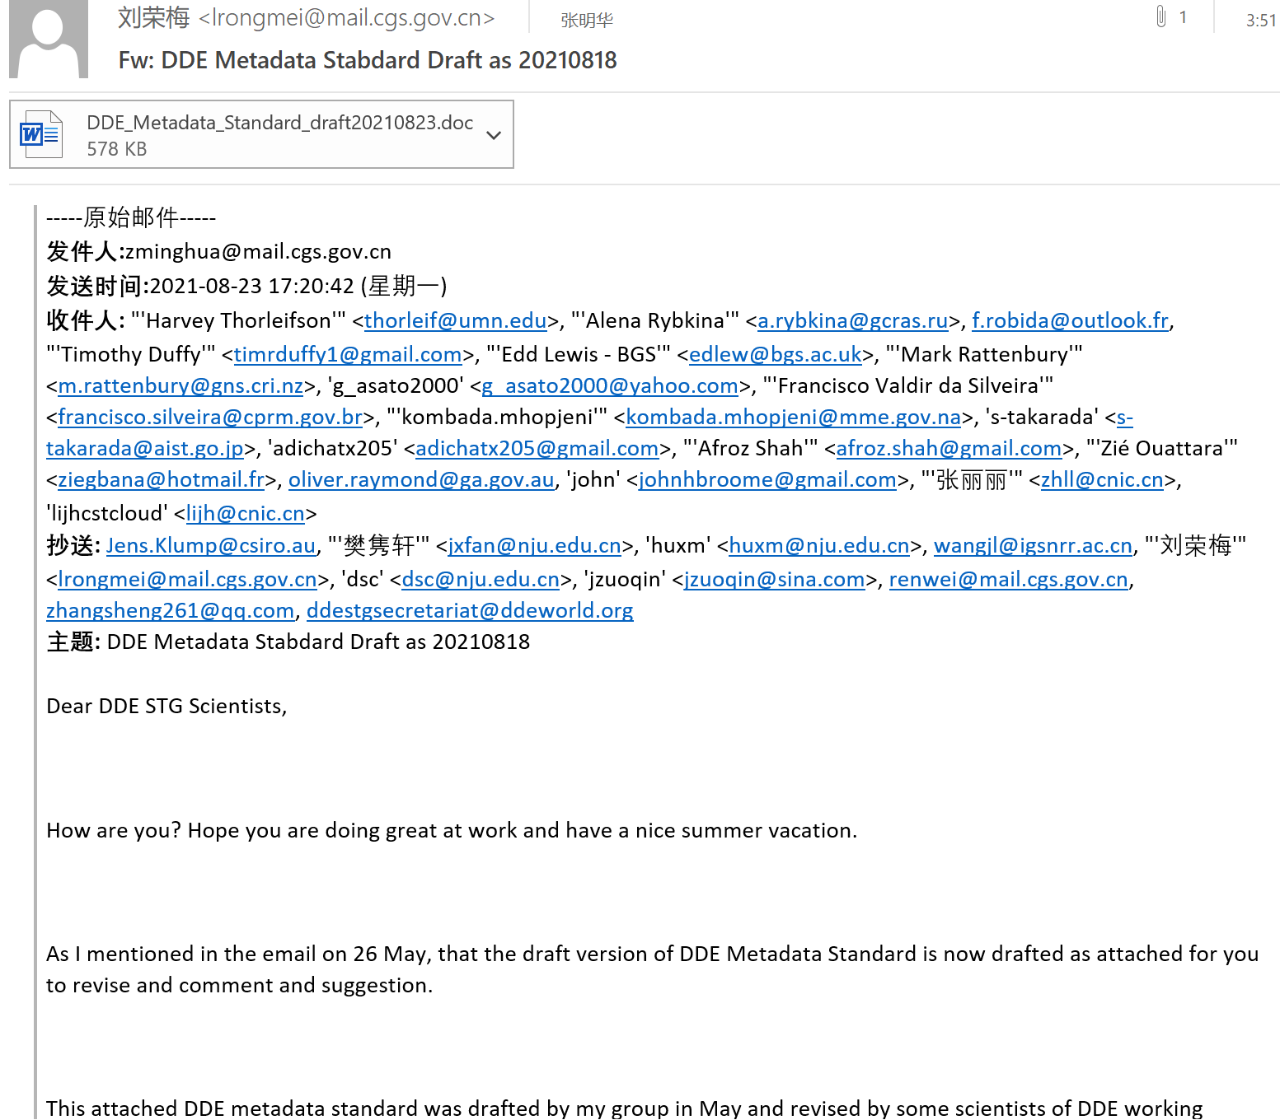
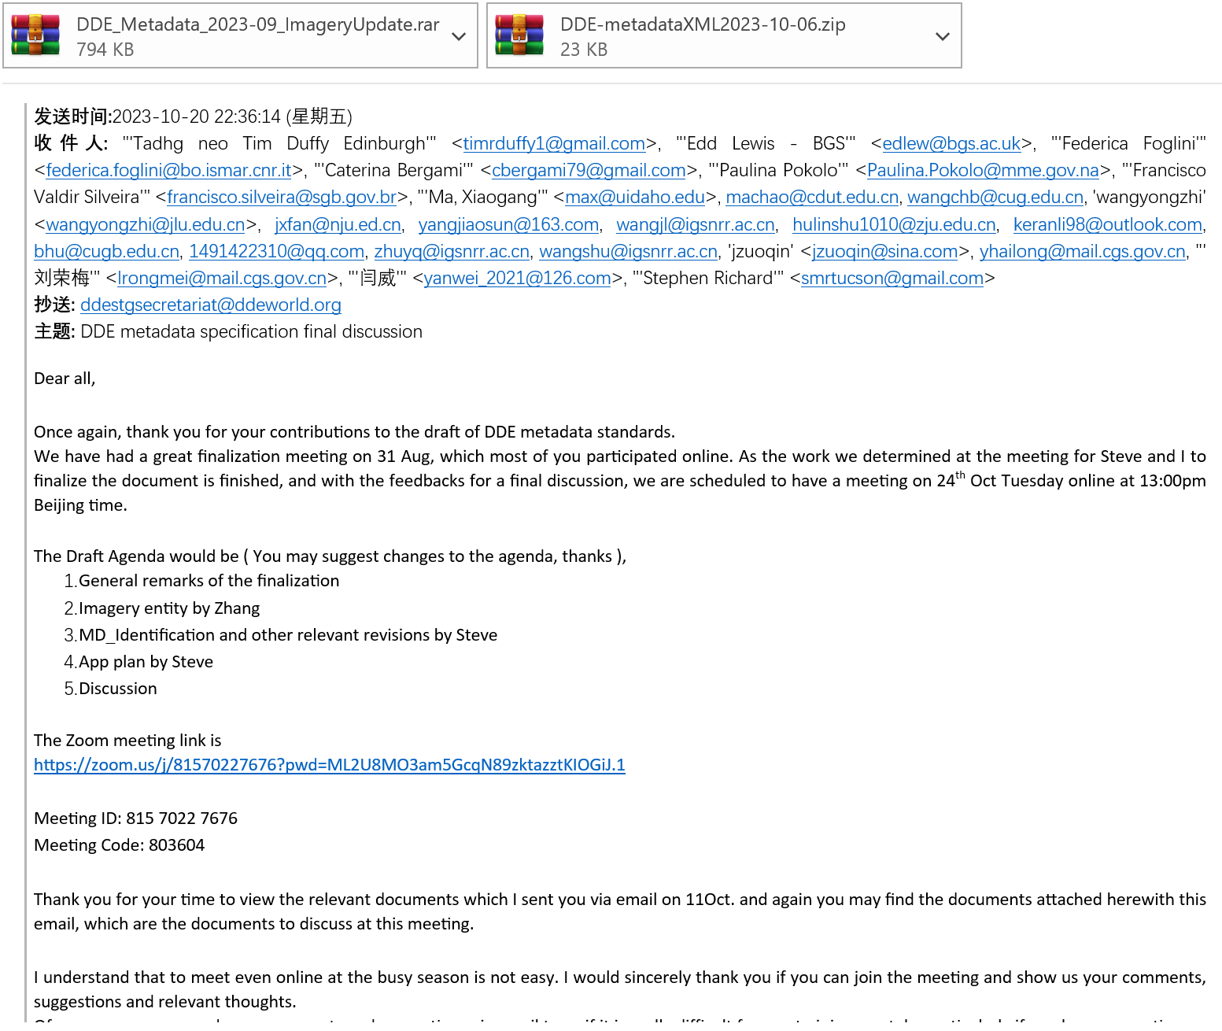
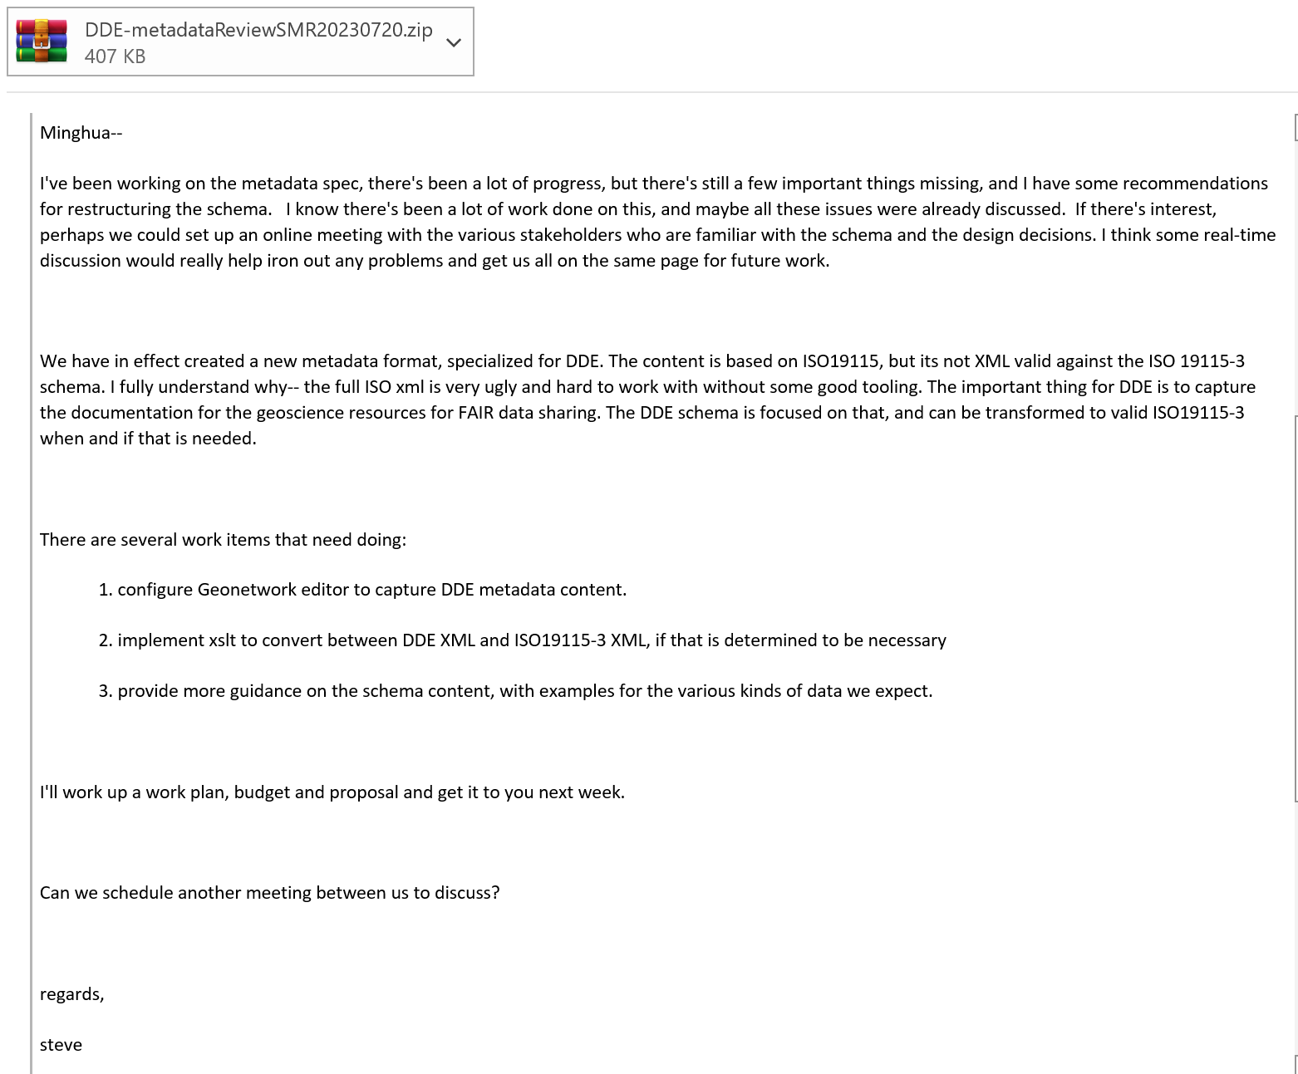
Main contributors in/out of DDE-STG/DDE WGs
Prof Zhang Minghua
Dr Stephen Richard
Dr Yu Hailong
Dr Tim Duffy
Dr Liu Rongmei
Prof Jiang Zuoqin
Dr Edd Lewis
Prof Wang Chengshan
Prof Li Xianhua
Dr Ma Chao
Prof Fan Junxuan
Prof Hu Xiumian
Dr Gabriel Asato
Mr Francisco Valdir
Prof Afraz Shah
Dr Federica Foglini
Dr Caterina Bergami
Prof Wang Juanle
Dr Hu Linshu
Dr Wang Chengbin
Prof Zhu Yunqiang
Dr Wangshu
Mr Fan Haiming
Dr Mark Rattenbury
Dr Ren Wei
Dr Zhang Sheng
Dr Xu Yiwei
Prof Bai Yuqi
Dr Liu Ruomei
Dr Shi Yukun
Prof Mashall Ma
Dr Alena Rybkina
Prof Wang Yingzhi
Dr Zhang Lili
Mr Yan Wei
Dr Yang jiao
Dr. Li Kai
Dr Yu Rui
……

Slide 16
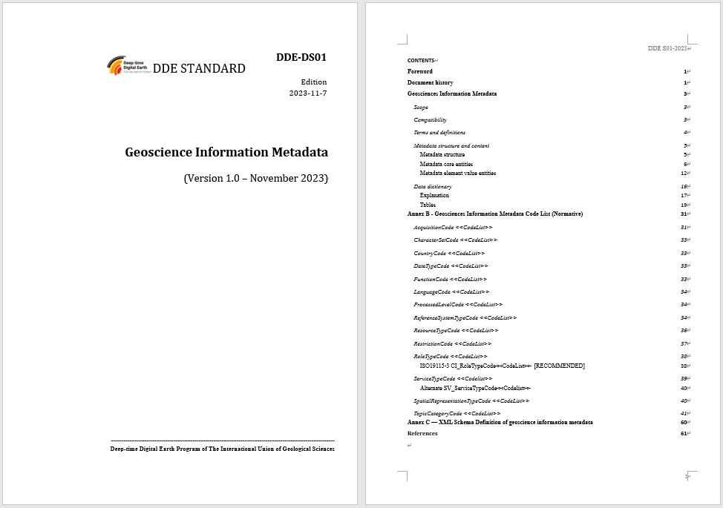
3. What is DDE geoscience information metadata standards?
A standard for core metadata of DDE with geoscience and deep-time characteristics.
6 entities(MD_Metadata, MD_Identification, SV_Service identification, MD_Imagery, MD_SpatialRepresentation, MD_Distribution, CI_Date, EX_GeographicExtent, MD_ Identifier, CI_OnlineResource, CI_Responsibility, EX_TemporalExtent, MD_Constraint ) and 87 elements (30 Mandatory), 16 code lists, and the XSD file.
more normative in structures and definitions with geosciences related contents, topic categories, data acquisition types and geologic time scale, etc.
41 secondary geoscientificInformation topicCategories for DDE geosciences, and dataSscience as 1 more first concept name.

Slide 17
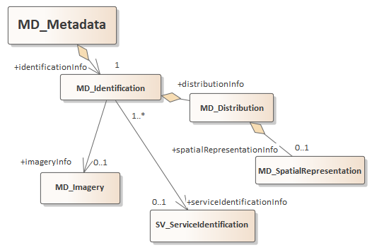
Structure
MD_Metadata
Identifier
Standard name
Dates
Responsibilities
MD_Metadata
about the metadata record itself
MD_Identification
Describe the content and provenance of any resource
Describe how to get resource
Extension points for resource specific properties

Slide 18

Resource Description
Resource identifier, title, abstract, authors, dates, keywords
Spatial and temporal extent
Access and usage constraints
Provenance: acquisition, lineage, sources
Data quality
Distribution information

Slide 19


Distribution
how to get the described resource in a useful representation
File format
OnlineResource -- information about accessing the resource: link function, profile, description
ResponsibleParty– distributor point of contact, etc.
SpatialRepresentation map projection, resolution apply to individual distributions

Slide 20



Service description
serviceType
operations
What can the service do
operatedDataset
If the service is tightly coupled to a particular dataset, describe that dataset
accessProperties
endpointDescription
Link to a service description document that is defined as part of the service protocol, e.g. OpenAPI, or OGC GetCapabilities.

Slide 21


Codelists
Date and DateTime ISO8601
LanguageCode<<CodeList>> ISO639
CharacterSetCode<<CodeList>> IANA
topicCategoryCode<< CodeList >>
SpatialRepresentationTypeCode<<CodeList> ISO19115
ReferenceSystemTypeCode<<CodeList>> ISO1911
RestrictionCode<<CodeList>> ISO19115
DDE identifier <<convention>>
9. Geological Time Scale ISC
AcquisitionCode<<CodeList>>
CountryCode<<CodeList>> ISO 3166
CI_RoleTypeCode<<CodeList>> ISO19115
SV_ServiceTypeCode<<Codelist>>
MD_ProcessedLevelCode<<CodeList>>
>

Slide 22




Products
This release:
Specification document
XML schema
XSL Tranforms to convert to and from ISO19115-3
Example instance documents

Slide 23




Next Steps
R. Crumb
Implement GeoNetwork schema profile for DDE
Harvest DDE or ISO19115-3 DDE
Search
Provide results in DDE, ISO19115-3
Testing with a variety of datasets and other resources in the scope of the DDE catalog

Slide 24





Thank you for your attention!

Slide 25
1.2 Metadata Standards
Metadata Contact
Data Identification Info
Responsible Party
ISO Metadata 19115
CCOP/ASEAN Geoninformation Standards
CGS metadata standard
Content Information
Distribution Info
Online Source
Spatial Representation
Metadata
Data Quality Info
Reference System
Citation
Metadata Maintenance
Language
Character Set
Hierarchy
Standard Name,
Version
Date
Metadata Constraints
Required
Application Schema Info
Conditional
or Optional
Portrayal Catalog Info
Extension Information

Slide 26



Why Metadata is import ?
Mark A. Musen
professor of medicine (biomedical informatics) and biomedical data science at Stanford University in California.
If we’re serious about sharing data, we need to develop the Standards that can make data FAIR.
Without appropriate metadata, data-sharing
mandates are pointless.
https://www.nature.com/articles/d41586-022-02820-7

